Slide 1
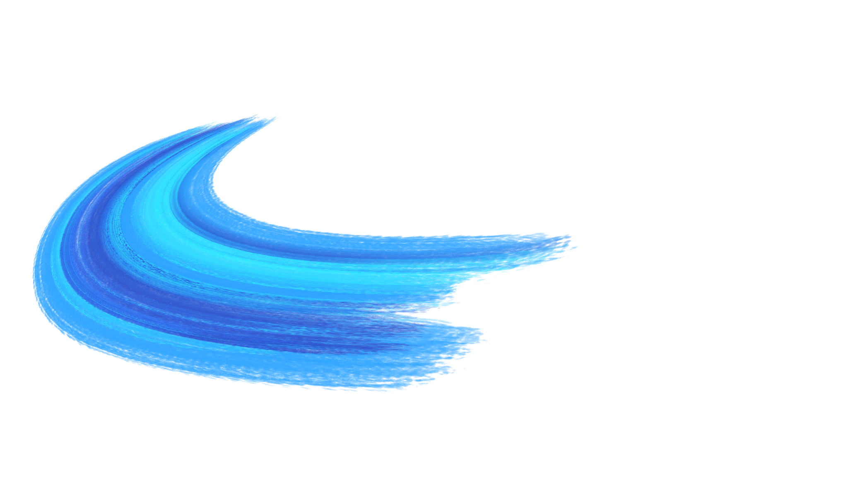

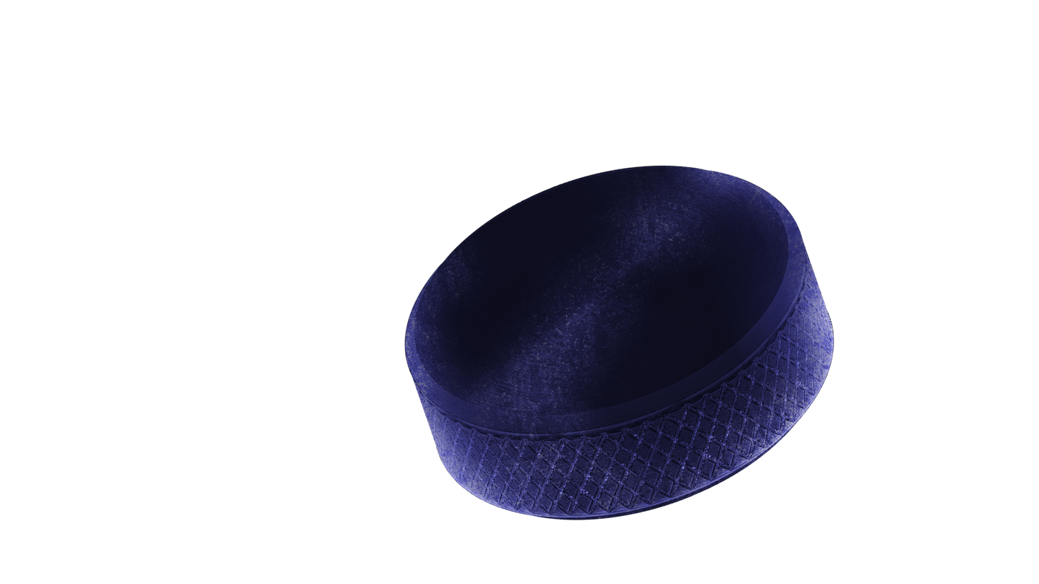
Improvements of the device

Slide 2



WHY YOU DIDNT USE IT
Lack of a comprehensive overview.
Absence of explanatory graphs and diagrams.
Missing physiological data.
No access to historical player information.
Lack of individual player assessments.
Requirement for positional overviews on the pitch to assist tactical planning (e.g., formations).
Limited functionality for injury prevention.
Absence of heart rate data; only metrics such as player load are available, which are not considered sufficiently useful.

Slide 3

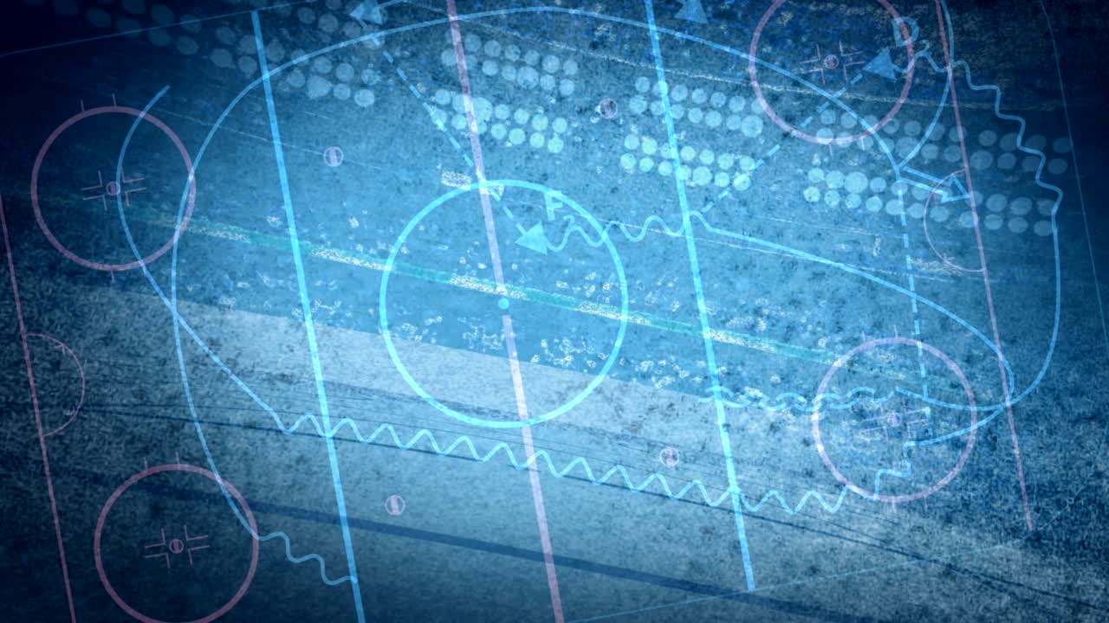


WHAT WE CAN DO NOW
We can integrate psychological data.
We can design a clear and structured overview of all relevant information.
We can develop informative graphs and diagrams tailored to user preferences, avoiding unnecessary complexity or overly technical presentations.
This will require additional stakeholder dialogue to ensure alignment with user needs.
We can incorporate historical data, including match statistics.
We can implement a player-specific panel allowing selection of individual athletes, with all relevant information displayed accordingly.
We can create a hockey rink visualization illustrating player positions and tactical formations.
We can estimate injury risk based on selected performance metrics and physiological data.
Regarding heart rate monitoring, this can be discussed further, as implementation is technically feasible.

Slide 4

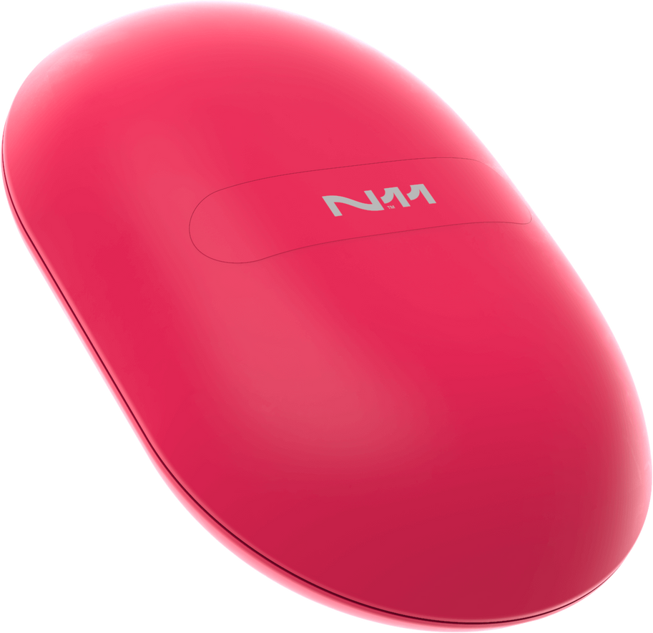
THE IMPORTENCE OF YOU STARTING TO USE THE DEVICE
Continuous use of the device is essential to ensure data reliability and validity over time. Regular data collection enables longitudinal analysis, supports individualized monitoring, improves injury risk assessment, and strengthens evidence-based decision-making. Without consistent usage, trends cannot be identified, limiting the system’s value for performance optimization and player health management.

Slide 5
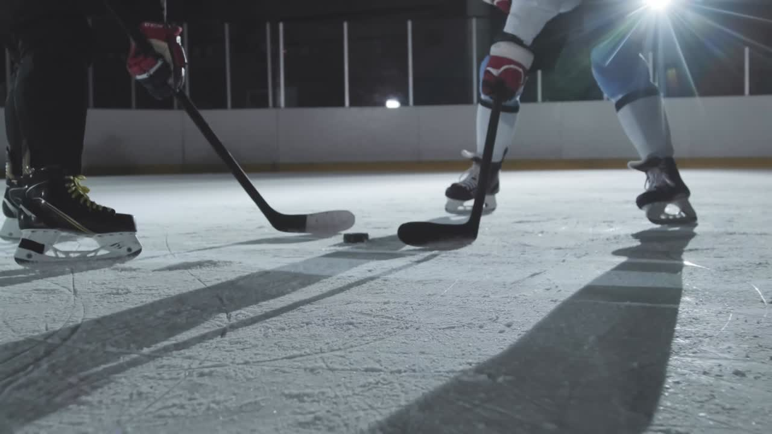
UNTIL NEXT TIME
New meeting in 2 weeks
I will provide a skeleton regarding the Design all of you would prefer

